Slide 1
OPER 618 Lesson 04 Further Solution Concepts for Normal Form Games
Dr. Brian J. Lunday
Office: Rm 201E, Bldg 641

Slide 2

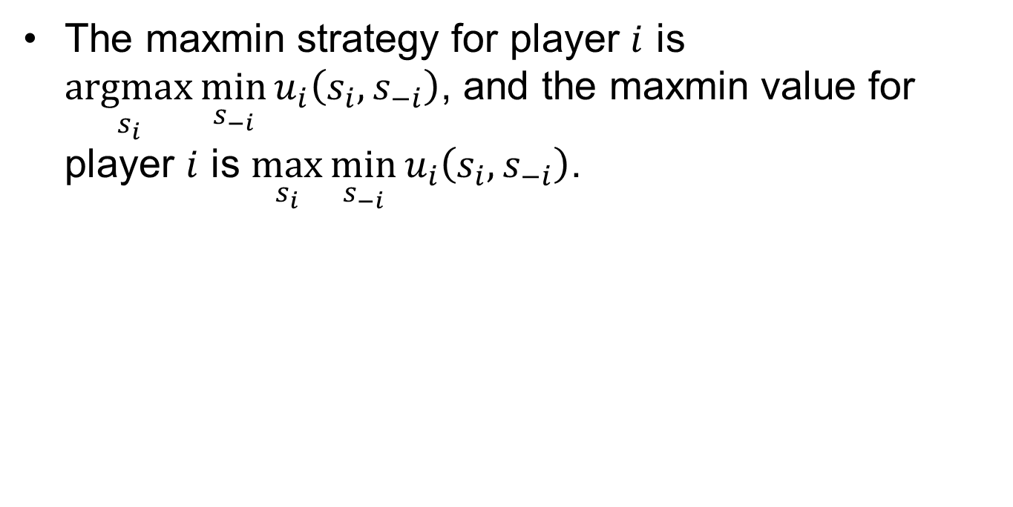
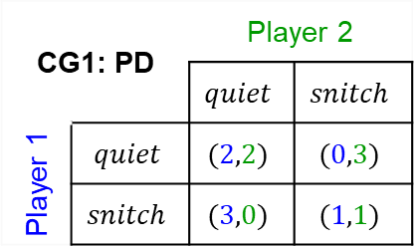
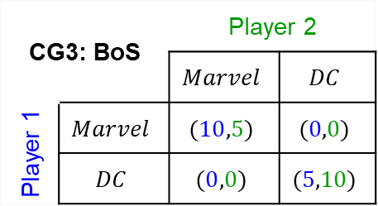
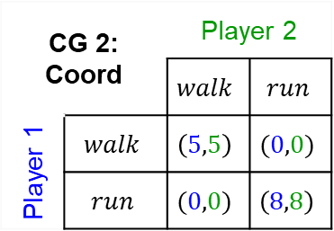
Maxmin
The maxmin strategy for player $i$ is $\underset{s_{i}}{argmax}{\min_{s_{−i}}{u_{i}\left(s_{i},s_{−i}\right)}}$, and the maxmin value for player $i$ is $\max_{s_{i}}{\min_{s_{−i}}{u_{i}\left(s_{i},s_{−i}\right)}}$.
CG1: PD |  | Player 2
 |  | $$quiet$$ | $$snitch$$
Player 1 | $$quiet$$ | $$(2,2)$$ | $$(0,3)$$
 | $$snitch$$ | $$(3,0)$$ | $$(1,1)$$
CG 2: Coord |  | Player 2
 |  | $$walk$$ | $$run$$
Player 1 | $$walk$$ | $$\left(5,5\right)$$ | $$(0,0)$$
 | $$run$$ | $$(0,0)$$ | $$\left(8,8\right)$$
CG3: BoS |  | Player 2
 |  | $$Marvel$$ | $$DC$$
Player 1 | $$Marvel$$ | $$(10,5)$$ | $$(0,0)$$
 | $$DC$$ | $$(0,0)$$ | $$(5,10)$$
CG4: MP |  | Player 2
 |  | $$heads$$ | $$tails$$
Player 1 | $$heads$$ | $$(1,−1)$$ | $$(−1,1)$$
 | $$tails$$ | $$(−1,1)$$ | $$(1,−1)$$

Slide 3
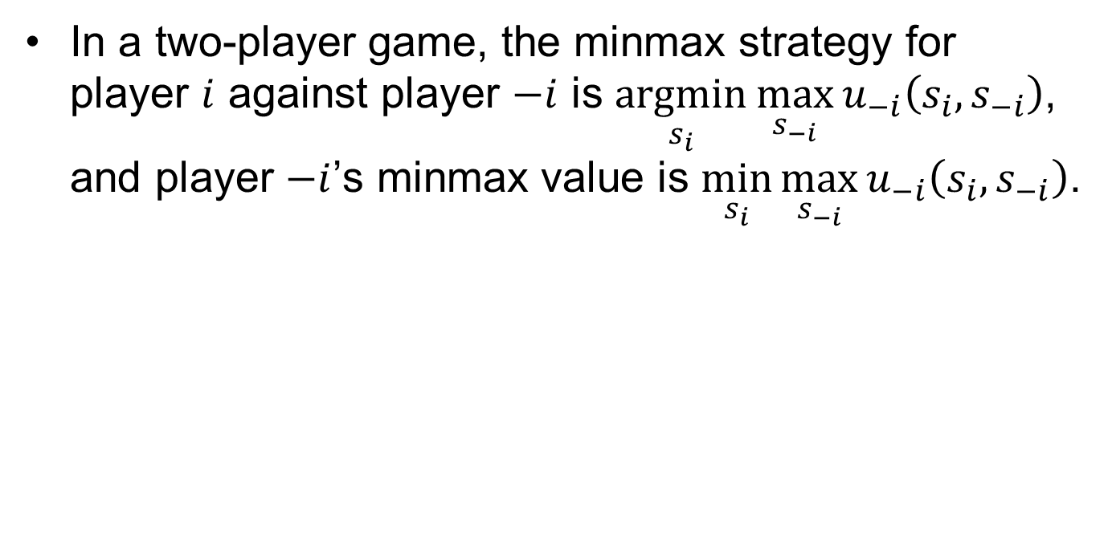
Minmax, two-player
In a two-player game, the minmax strategy for player $i$ against player $−i$ is $\underset{s_{i}}{argmin}{\max_{s_{−i}}{u_{−i}\left(s_{i},s_{−i}\right)}}$, and player $−i$’s minmax value is $\min_{s_{i}}{\max_{s_{−i}}{u_{−i}\left(s_{i},s_{−i}\right)}}$.
CG1: PD |  | Player 2
 |  | $$quiet$$ | $$snitch$$
Player 1 | $$quiet$$ | $$(2,2)$$ | $$(0,3)$$
 | $$snitch$$ | $$(3,0)$$ | $$(1,1)$$
CG 2: Coord |  | Player 2
 |  | $$walk$$ | $$run$$
Player 1 | $$walk$$ | $$\left(5,5\right)$$ | $$(0,0)$$
 | $$run$$ | $$(0,0)$$ | $$\left(8,8\right)$$
CG3: BoS |  | Player 2
 |  | $$Marvel$$ | $$DC$$
Player 1 | $$Marvel$$ | $$(10,5)$$ | $$(0,0)$$
 | $$DC$$ | $$(0,0)$$ | $$(5,10)$$
CG4: MP |  | Player 2
 |  | $$heads$$ | $$tails$$
Player 1 | $$heads$$ | $$(1,−1)$$ | $$(−1,1)$$
 | $$tails$$ | $$(−1,1)$$ | $$(1,−1)$$

Slide 4
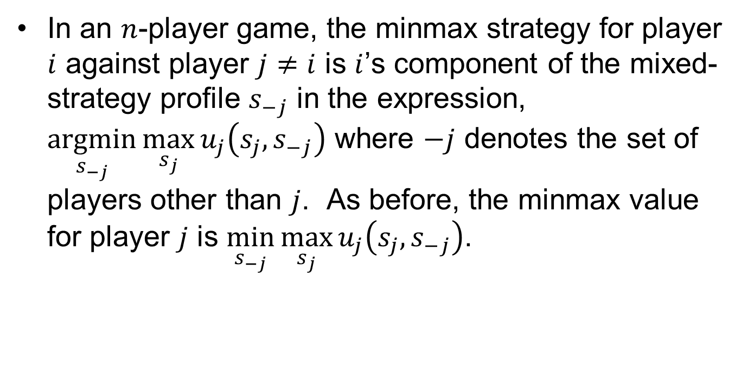

Minmax, $n$-player
In an $n$-player game, the minmax strategy for player $i$ against player $j≠i$ is $i$’s component of the mixed-strategy profile $s_{−j}$ in the expression, $\underset{s_{−j}}{argmin}{\max_{s_{j}}{u_{j}\left(s_{j},s_{−j}\right)}}$ where $−j$ denotes the set of players other than $j$. As before, the minmax value for player $j$ is $\min_{s_{−j}}{\max_{s_{j}}{u_{j}\left(s_{j},s_{−j}\right)}}$.

Slide 5
Minimax Theorem
In a finite, two-player, zero-sum game, in any Nash equilibrium each player receives a payoff that is equal to both his maxmin value and his minmax value.
CG1: PD |  | Player 2
 |  | $$quiet$$ | $$snitch$$
Player 1 | $$quiet$$ | $$(2,2)$$ | $$(0,3)$$
 | $$snitch$$ | $$(3,0)$$ | $$(1,1)$$
CG 2: Coord |  | Player 2
 |  | $$walk$$ | $$run$$
Player 1 | $$walk$$ | $$\left(5,5\right)$$ | $$(0,0)$$
 | $$run$$ | $$(0,0)$$ | $$\left(8,8\right)$$
CG3: BoS |  | Player 2
 |  | $$Marvel$$ | $$DC$$
Player 1 | $$Marvel$$ | $$(10,5)$$ | $$(0,0)$$
 | $$DC$$ | $$(0,0)$$ | $$(5,10)$$
CG4: MP |  | Player 2
 |  | $$heads$$ | $$tails$$
Player 1 | $$heads$$ | $$(1,−1)$$ | $$(−1,1)$$
 | $$tails$$ | $$(−1,1)$$ | $$(1,−1)$$

Slide 6
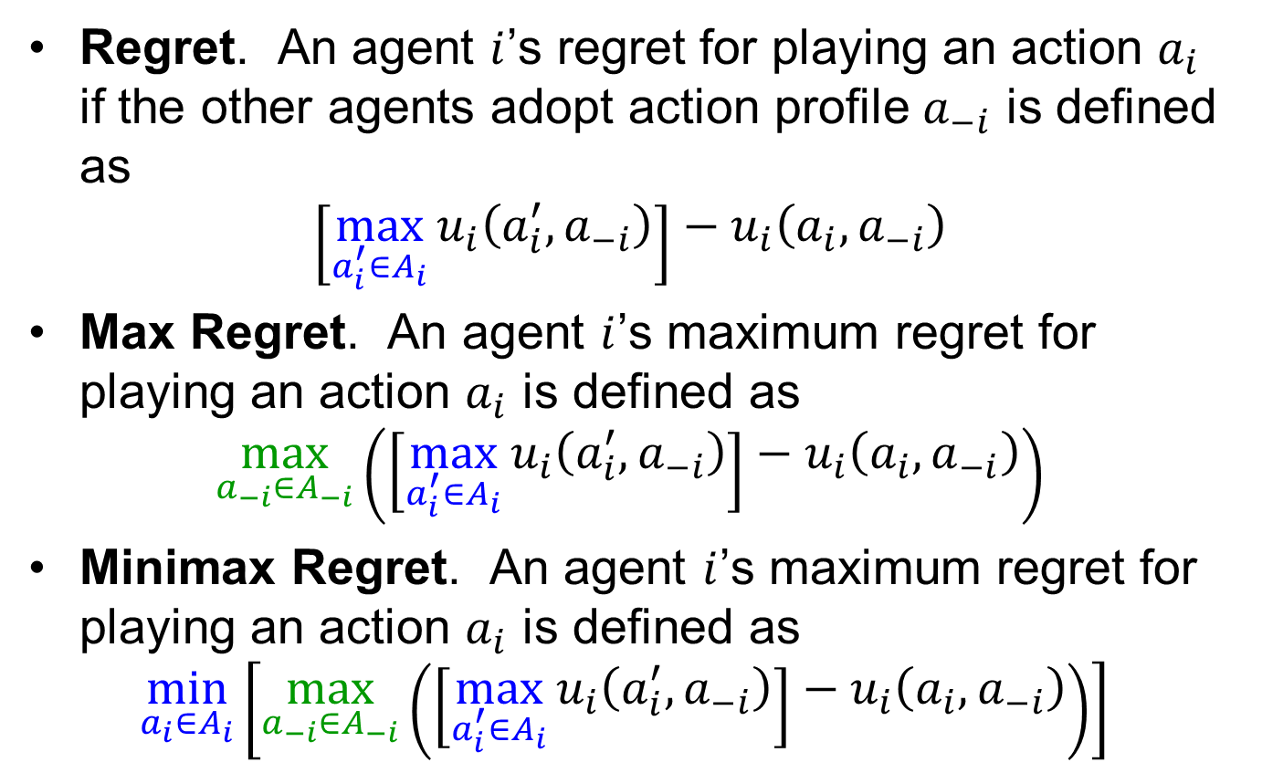
Forms of Regret
Regret. An agent $i$’s regret for playing an action $a_{i}$ if the other agents adopt action profile $a_{−i}$ is defined as
$$\left[\max_{a_{i}^{′}∈A_{i}}{u_{i}\left(a_{i}^{′},a_{−i}\right)}\right]−u_{i}\left(a_{i},a_{−i}\right)$$
Max Regret. An agent $i$’s maximum regret for playing an action $a_{i}$ is defined as
$$\max_{a_{−i}∈A_{−i}}\left(\left[\max_{a_{i}^{′}∈A_{i}}{u_{i}\left(a_{i}^{′},a_{−i}\right)}\right]−u_{i}\left(a_{i},a_{−i}\right)\right)$$
Minimax Regret. An agent $i$’s maximum regret for playing an action $a_{i}$ is defined as
$$\min_{a_{i}∈A_{i}}\left[\max_{a_{−i}∈A_{−i}}\left(\left[\max_{a_{i}^{′}∈A_{i}}{u_{i}\left(a_{i}^{′},a_{−i}\right)}\right]−u_{i}\left(a_{i},a_{−i}\right)\right)\right]$$

Slide 7
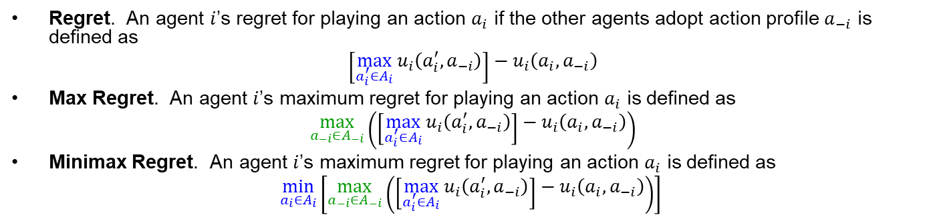

Forms of Regret
Regret. An agent $i$’s regret for playing an action $a_{i}$ if the other agents adopt action profile $a_{−i}$ is defined as
$$\left[\max_{a_{i}^{′}∈A_{i}}{u_{i}\left(a_{i}^{′},a_{−i}\right)}\right]−u_{i}\left(a_{i},a_{−i}\right)$$
Max Regret. An agent $i$’s maximum regret for playing an action $a_{i}$ is defined as
$$\max_{a_{−i}∈A_{−i}}\left(\left[\max_{a_{i}^{′}∈A_{i}}{u_{i}\left(a_{i}^{′},a_{−i}\right)}\right]−u_{i}\left(a_{i},a_{−i}\right)\right)$$
Minimax Regret. An agent $i$’s maximum regret for playing an action $a_{i}$ is defined as
$$\min_{a_{i}∈A_{i}}\left[\max_{a_{−i}∈A_{−i}}\left(\left[\max_{a_{i}^{′}∈A_{i}}{u_{i}\left(a_{i}^{′},a_{−i}\right)}\right]−u_{i}\left(a_{i},a_{−i}\right)\right)\right]$$
CG1: PD |  | Player 2
 |  | $$quiet$$ | $$snitch$$
Player 1 | $$quiet$$ | $$(2,2)$$ | $$(0,3)$$
 | $$snitch$$ | $$(3,0)$$ | $$(1,1)$$
CG 2: Coord |  | Player 2
 |  | $$walk$$ | $$run$$
Player 1 | $$walk$$ | $$\left(5,5\right)$$ | $$(0,0)$$
 | $$run$$ | $$(0,0)$$ | $$\left(8,8\right)$$
CG3: BoS |  | Player 2
 |  | $$Marvel$$ | $$DC$$
Player 1 | $$Marvel$$ | $$(10,5)$$ | $$(0,0)$$
 | $$DC$$ | $$(0,0)$$ | $$(5,10)$$
CG4: MP |  | Player 2
 |  | $$heads$$ | $$tails$$
Player 1 | $$heads$$ | $$(1,−1)$$ | $$(−1,1)$$
 | $$tails$$ | $$(−1,1)$$ | $$(1,−1)$$

Slide 8
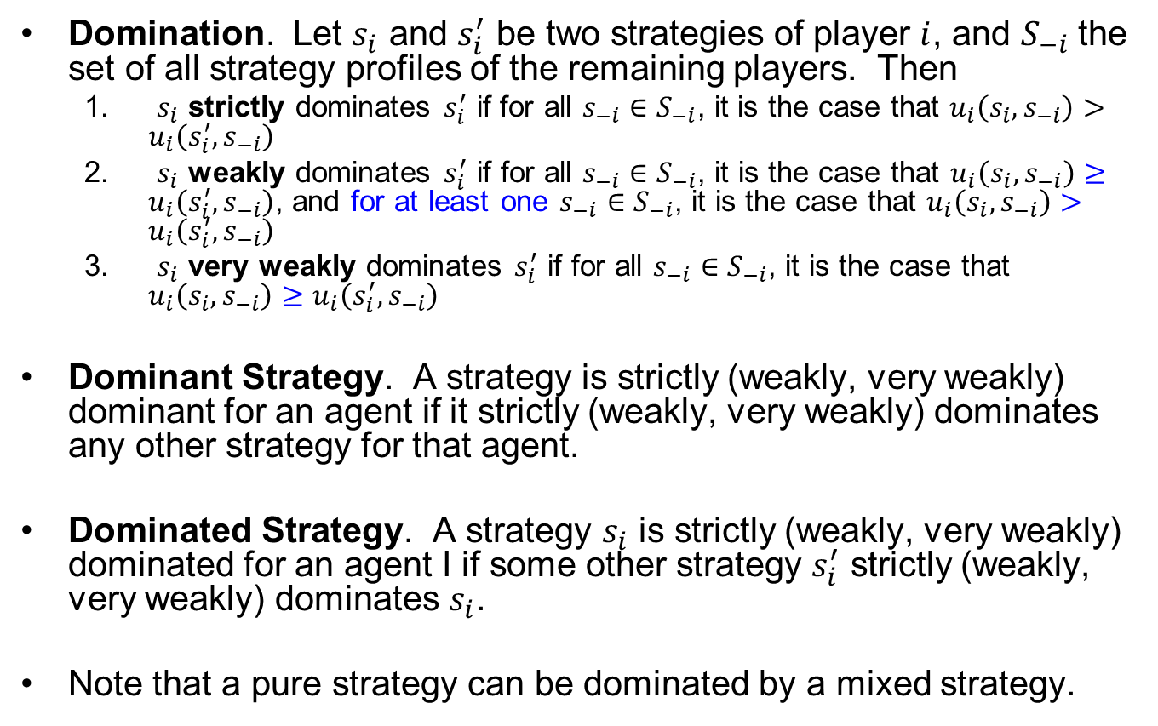
Domination
Domination. Let $s_{i}$ and $s_{i}^{′}$ be two strategies of player $i$, and $S_{−i}$ the set of all strategy profiles of the remaining players. Then
$s_{i}$ strictly dominates $s_{i}^{′}$ if for all $s_{−i}∈S_{−i}$, it is the case that $u_{i}\left(s_{i},s_{−i}\right)>u_{i}\left(s_{i}^{′},s_{−i}\right)$
$s_{i}$ weakly dominates $s_{i}^{′}$ if for all $s_{−i}∈S_{−i}$, it is the case that $u_{i}\left(s_{i},s_{−i}\right)≥u_{i}\left(s_{i}^{′},s_{−i}\right)$, and for at least one $s_{−i}∈S_{−i}$, it is the case that $u_{i}\left(s_{i},s_{−i}\right)>u_{i}\left(s_{i}^{′},s_{−i}\right)$
$s_{i}$ very weakly dominates $s_{i}^{′}$ if for all $s_{−i}∈S_{−i}$, it is the case that $u_{i}\left(s_{i},s_{−i}\right)≥u_{i}\left(s_{i}^{′},s_{−i}\right)$
Dominant Strategy. A strategy is strictly (weakly, very weakly) dominant for an agent if it strictly (weakly, very weakly) dominates any other strategy for that agent.
Dominated Strategy. A strategy $s_{i}$ is strictly (weakly, very weakly) dominated for an agent I if some other strategy $s_{i}^{′}$ strictly (weakly, very weakly) dominates $s_{i}$.
Note that a pure strategy can be dominated by a mixed strategy.

Slide 9
Iterated Elimination of Dominated Strategies (IEDS)
The order in which strictly dominated strategies are eliminated from consideration does not affect the analysis of a game.
The same cannot be said for other types of domination.

Slide 10
Class Exercise
Construct two games, one each in which
IEDS of strictly dominated strategies solves the game
IEDS of strictly or weakly (or very weakly) dominated strategies yields different outcomes, depending on whether you analyze Player 1 or Player 2 first

Slide 11
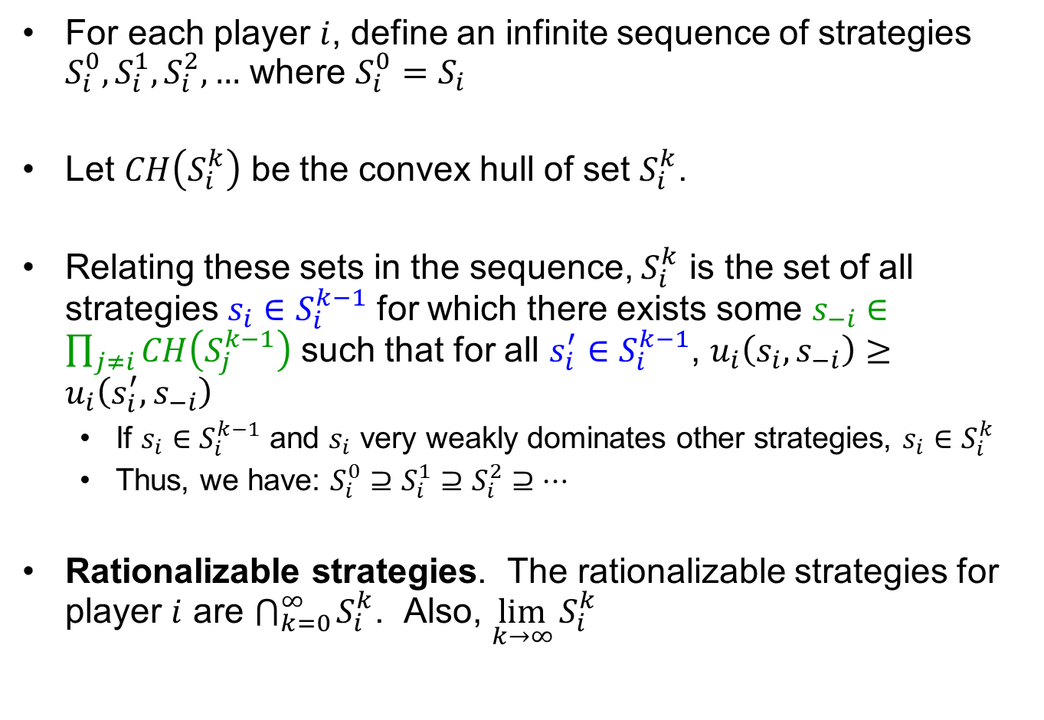
Rationalizability
For each player $i$, define an infinite sequence of strategies $S_{i}^{0},S_{i}^{1},S_{i}^{2},…$ where $S_{i}^{0}=S_{i}$
Let $CH\left(S_{i}^{k}\right)$ be the convex hull of set $S_{i}^{k}$.
Relating these sets in the sequence, $S_{i}^{k}$ is the set of all strategies $s_{i}∈S_{i}^{k−1}$ for which there exists some $s_{−i}∈\prod_{j≠i}{CH\left(S_{j}^{k−1}\right)}$ such that for all $s_{i}^{′}∈S_{i}^{k−1}$, $u_{i}\left(s_{i},s_{−i}\right)≥u_{i}\left(s_{i}^{′},s_{−i}\right)$
If $s_{i}∈S_{i}^{k−1}$ and $s_{i}$ very weakly dominates other strategies, $s_{i}∈S_{i}^{k}$
Thus, we have: $S_{i}^{0}⊇S_{i}^{1}⊇S_{i}^{2}⊇…$
Rationalizable strategies. The rationalizable strategies for player $i$ are $\bigcap_{k=0}^{∞}{S_{i}^{k}}$. Also, $\lim_{k→∞}{S_{i}^{k}}$

Slide 12
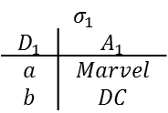
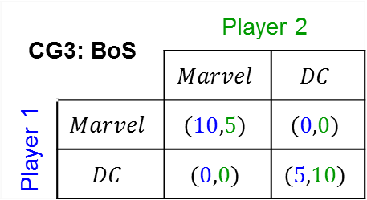
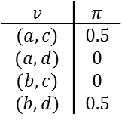
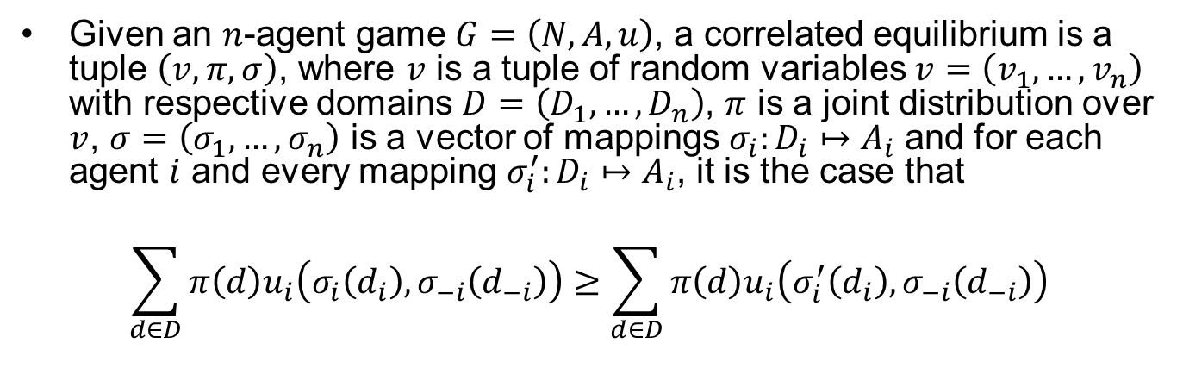



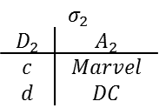
Correlated Equilibrium (1 of 2)
Given an $n$-agent game $G=\left(N,A,u\right)$, a correlated equilibrium is a tuple $\left(v,π,σ\right)$, where $v$ is a tuple of random variables $v=\left(v_{1},…,v_{n}\right)$ with respective domains $D=\left(D_{1},…,D_{n}\right)$, $π$ is a joint distribution over $v$, $σ=\left(σ_{1},…,σ_{n}\right)$ is a vector of mappings $σ_{i}:D_{i}↦A_{i}$ and for each agent $i$ and every mapping $σ_{i}^{′}:D_{i}↦A_{i}$, it is the case that
$$\sum_{d∈D}{π\left(d\right)u_{i}\left(σ_{i}\left(d_{i}\right),σ_{−i}\left(d_{−i}\right)\right)}≥\sum_{d∈D}{π\left(d\right)u_{i}\left(σ_{i}^{′}\left(d_{i}\right), σ_{−i}\left(d_{−i}\right)\right)}$$
CG3: BoS |  | Player 2
 |  | $$Marvel$$ | $$DC$$
Player 1 | $$Marvel$$ | $$(10,5)$$ | $$(0,0)$$
 | $$DC$$ | $$(0,0)$$ | $$(5,10)$$
Nash equilibria & corresponding utilities
$$s=\left(s_{1},s_{2}\right)=\left\{\left(\left[\begin{matrix}1 \\ 0\end{matrix}\right],\left[\begin{matrix}1 \\ 0\end{matrix}\right]\right),\left(\left[\begin{matrix}0.6\overline{6} \\ 0.3\overline{3}\end{matrix}\right],\left[\begin{matrix}0.3\overline{3} \\ 0.6\overline{6}\end{matrix}\right]\right),\left(\left[\begin{matrix}0 \\ 1\end{matrix}\right],\left[\begin{matrix}0 \\ 1\end{matrix}\right]\right)\right\}$$
$$u=\left(u_{1},u_{2}\right)=\left\{\left(10,5\right),\left(3.3\overline{3},3.3\overline{3}\right),\left(5,10\right)\right\}$$
Correlated equilibrium
$v=\left(v_{1},v_{2}\right) with$
$D_{1}=\left\{a,b\right\}, D_{2}=\left\{c,d\right\}$
$$v$$ | $$π$$
$$(a,c)$$ | $$0.5$$
$$(a,d)$$ | $$0$$
$$(b,c)$$ | $$0$$
$$(b,d)$$ | $$0.5$$
$$σ_{1}$$
$$D_{1}$$ | $$A_{1}$$
$$a$$ | $$Marvel$$
$$b$$ | $$DC$$
$$σ_{2}$$
$$D_{2}$$ | $$A_{2}$$
$$c$$ | $$Marvel$$
$$d$$ | $$DC$$
$$u=\left(u_{1},u_{2}\right)=\left(7.5, 7.5\right)$$

Slide 13


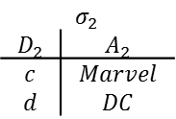
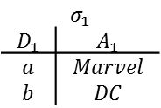
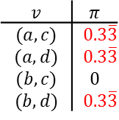
Correlated Equilibrium (2 of 2)
CG3: BoS |  | Player 2
 |  | $$Marvel$$ | $$DC$$
Player 1 | $$Marvel$$ | $$(10,5)$$ | $$(0,0)$$
 | $$DC$$ | $$(0,0)$$ | $$(5,10)$$
Correlated equilibrium (same as previous slide)
$v=\left(v_{1},v_{2}\right) with$
$D_{1}=\left\{a,b\right\}, D_{2}=\left\{c,d\right\}$
$$v$$ | $$π$$
$$(a,c)$$ | $$0.5$$
$$(a,d)$$ | $$0$$
$$(b,c)$$ | $$0$$
$$(b,d)$$ | $$0.5$$
$$σ_{1}$$
$$D_{1}$$ | $$A_{1}$$
$$a$$ | $$Marvel$$
$$b$$ | $$DC$$
$$σ_{2}$$
$$D_{2}$$ | $$A_{2}$$
$$c$$ | $$Marvel$$
$$d$$ | $$DC$$
$$u=\left(u_{1},u_{2}\right)=\left(7.5, 7.5\right)$$
Another correlated equilibrium solution
$v=\left(v_{1},v_{2}\right) with$
$D_{1}=\left\{a,b\right\}, D_{2}=\left\{c,d\right\}$
$$v$$ | $$π$$
$$(a,c)$$ | $$0.3\overline{3}$$
$$(a,d)$$ | $$0.3\overline{3}$$
$$(b,c)$$ | $$0$$
$$(b,d)$$ | $$0.3\overline{3}$$
$$σ_{1}$$
$$D_{1}$$ | $$A_{1}$$
$$a$$ | $$Marvel$$
$$b$$ | $$DC$$
$$σ_{2}$$
$$D_{2}$$ | $$A_{2}$$
$$c$$ | $$Marvel$$
$$d$$ | $$DC$$
$$u=\left(u_{1},u_{2}\right)=\left(5, 5\right)$$

Slide 14
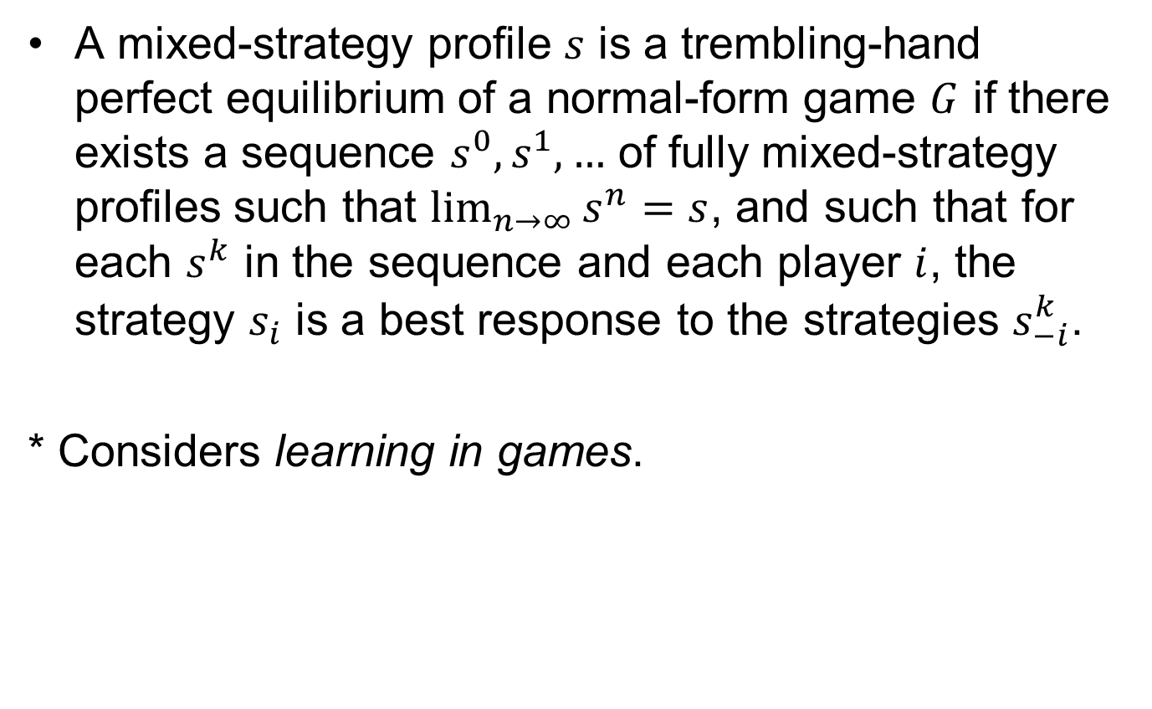
Trembling-hand Perfect Equilibrium
A mixed-strategy profile $s$ is a trembling-hand perfect equilibrium of a normal-form game $G$ if there exists a sequence $s^{0},s^{1},…$ of fully mixed-strategy profiles such that $\lim_{n→∞}{s^{n}}=s$, and such that for each $s^{k}$ in the sequence and each player $i$, the strategy $s_{i}$ is a best response to the strategies $s_{−i}^{k}$.
* Considers learning in games.

Slide 15
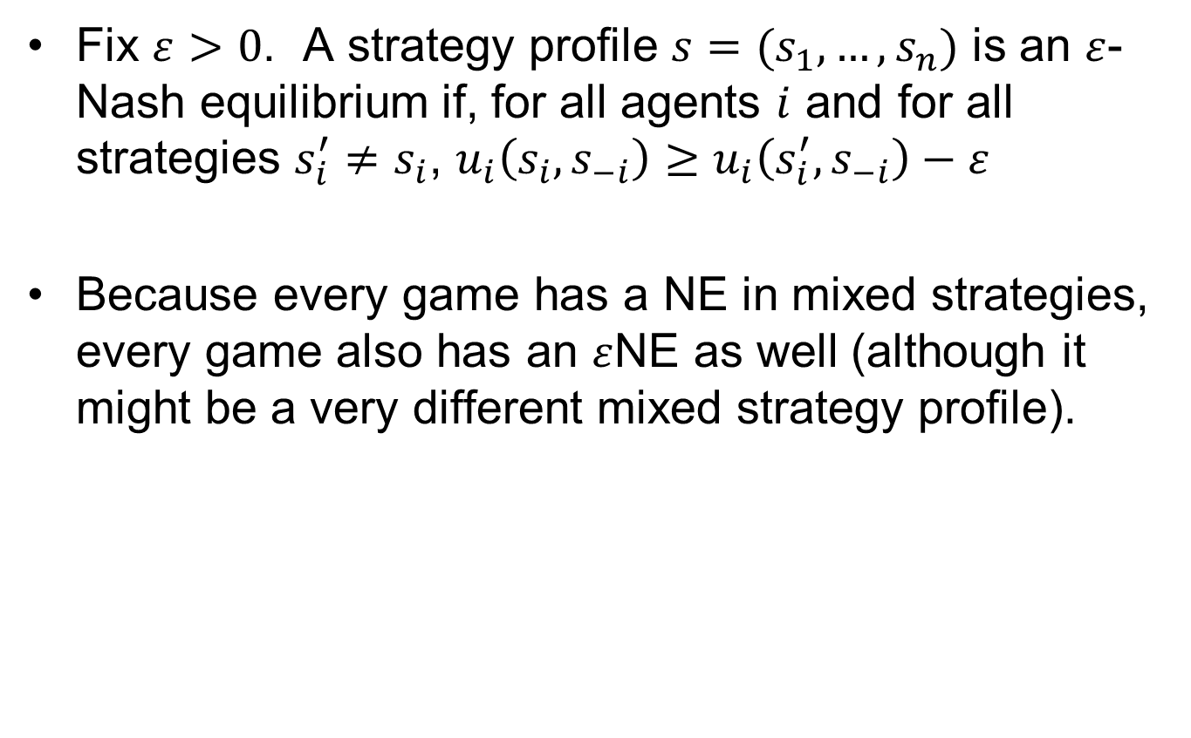

$ε$-Nash Equilibrium
Fix $ε>0$. A strategy profile $s=(s_{1},…,s_{n})$ is an $ε$-Nash equilibrium if, for all agents $i$ and for all strategies $s_{i}^{′}≠s_{i}$, $u_{i}\left(s_{i},s_{−i}\right)≥u_{i}\left(s_{i}^{′},s_{−i}\right)−ε$
Because every game has a NE in mixed strategies, every game also has an $ε$NE as well (although it might be a very different mixed strategy profile).

Slide 16
Questions & Discussion

